Slide 1
Overview of
Child Development

Slide 2
Developmental Psychology
The scientific study of biological, cognitive, social, and personality development throughout the life span
A major issue in developmental psychology is the nature-versus-nurture question
Do our traits and behaviors result from heredity (nature) or the environment (nurture)?

Slide 3
Child Development
Definition:
  Change in the child that occurs over time. Changes follow an orderly pattern that moves toward greater complexity and enhances survival.
Periods of development:
  Prenatal period: from conception to birth
  Infancy and toddlerhood: birth to 2 years
  Early childhood: 2-6 years old
  Middle childhood: 6-12 years old
  Adolescence: 12-19 years old

Slide 4
Domains of Development
Development is described in three domains, but growth
in one domain influences the other domains.
Physical Domain:
  body size, body proportions, appearance, brain development, motor development, perception capacities, physical health.
Cognitive Domain:
  thought processes and intellectual abilities including attention, memory, problem solving, imagination, creativity, academic and everyday knowledge, metacognition, and language.
Social Domain: Social identity, moral reasoning, understanding others, interpersonal skills, and friendships.
Emotional self-knowledge (self-esteem, metacognition, sexual identity, ethnic identity), understanding and expression of emotions, self-regulation, temperament.

Slide 5
Theories
What is a theory?
  Orderly set of ideas which describe, explain, and predict behavior.
Why are theories important?
  To give meaning to what we observe.
  As a basis for action -- finding ways to improve the lives and education of children.

Slide 6
Origins of Child Development Theories

Slide 7
6th - 15th centuries
Medieval period
Preformationism: children seen as little adults.
Childhood is not a unique phase.
Children were cared for until they could begin caring for themselves, around 7 years old.
Children treated as adults (e.g. their clothing, worked at adult jobs, could be married, were made into kings, were imprisoned or hanged as adults.)

Slide 8
16th Century
Reformation period
Puritan religion influenced how children were viewed.
Children were born evil, and must be civilized.
A goal emerged to raise children effectively.
Special books were designed for children.

Slide 9

17th Century
Age of Enlightenment
John Locke believed in tabula rasa
Children develop in response to nurturing.
Forerunner of behaviorism
www.cooperativeindividualism.org/ locke-john.jpg

Slide 10
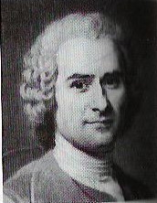
18th Century
Age of Reason
Jean-Jacques Rousseau
  children were noble savages, born with an innate sense of morality; the timing of growth should not be interfered with.
Rousseau used the idea of stages of development.
Forerunner of maturationist beliefs

Slide 11
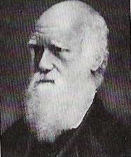
19th Century
Industrial Revolution
Charles Darwin
  theories of natural selection and survival of the fittest
Darwin made parallels between human prenatal growth and other animals.
Forerunner of ethology

Slide 12
20th Century
Theories about children's development expanded around the world.
Childhood was seen as worthy of special attention.
Laws were passed to protect children,

Slide 13
Psychoanalytical Theories
Beliefs focus on the formation of personality. According to this approach, children move through various stages, confronting conflicts between biological drives and social expectations.

Slide 14
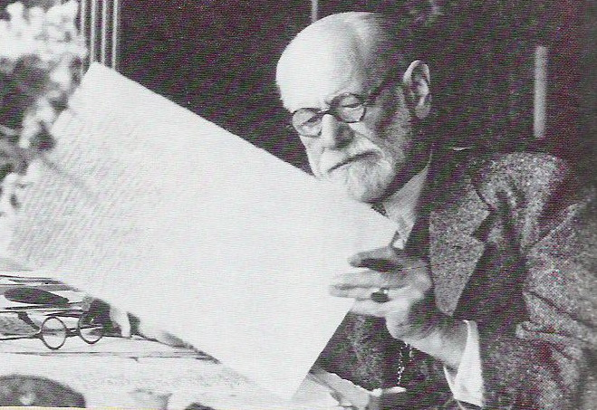
Sigmund Freud
Psychosexual Theory
Was based on his therapy with troubled adults.
He emphasized that a child's personality is formed by the ways which his parents managed his sexual and aggressive drives.

Slide 15
Cognitive Theories
Beliefs that describe how children learn

Slide 16
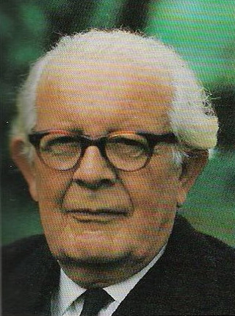
Jean Piaget
Cognitive development theory
Children "construct" their understanding of the world through their active involvement and interactions.
Studied his 3 children to focus not on what they knew but how they knew it.
Described children's understanding as their "schemas” and how they use:
  assimilation
  accommodation.

Slide 17
Piaget’s Theory of
Cognitive Development
Piaget did not conduct formal experiments, but rather loosely structured interviews in which he posed problems for children to solve, observed their actions carefully, and questioned them about their solutions
  Was particularly interested in children’s error, which would provide insights into children’s thought processes
  Assumed that a child is an active
  seeker of knowledge and gains an understanding of the world by operating on it

Slide 18
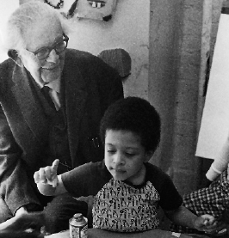
Schemas
Organized units of knowledge about objects, events, and actions
Cognitive adaptation
involves two processes
  Assimilation is the
  interpretation of new
  experiences in terms of
  present schemes
  Accommodation is the
  modification of present
  schemes to fit with new
  experiences

Slide 19


Schemas
For example, a child may call all four-legged creatures “doggie”
  The child learns he needs to accommodate (i.e., change) his schemes, as only one type of four-legged creature is “dog”
  It is through accommodation that the number and complexity of a child’s schemes increase and learning
  occurs

Slide 20
Piaget’s Stages of
Cognitive Development
Sensorimotor | Birth to 2 years
Preoperational | 2 to 6 years
Concrete operational | 6 to 12 years
Formal operational | 12+ years

Slide 21
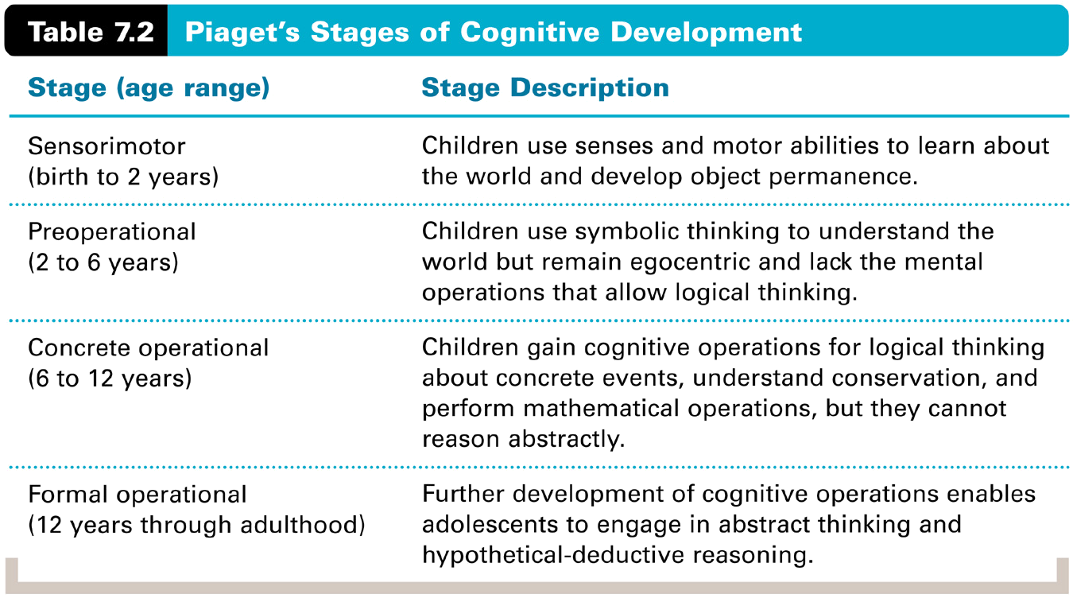
Piaget’s Stages of
Cognitive Development

Slide 22
Sensorimotor Stage
Infant learns about the world through their sensory and motor interactions (including reflexes)
Lack object permanence, the knowledge than an object exists independent of perceptual contact
Symbolic representation of objects and events starts to develop during the latter part of the sensorimotor stage (e.g., use of telegraphic speech)

Slide 23
Preoperational Stage
The child’s thinking becomes more symbolic and language-based, but remains egocentric and lacks the mental operations that allow logical thinking
Egocentrism is the inability to distinguish one’s own perceptions, thoughts, and feelings from those of others
  Cannot perceive the world from another person’s perspective
The child, however, can pretend, imagine, and engage in make-believe play

Slide 24

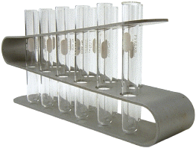
Preoperational Stage
Conservation is the knowledge that the quantitative properties of an object (such as mass, volume, and number) remain the same despite changes in
appearance
  Some grasp of conservation
  marks the end of the
  preoperational stage and
  the beginning of the
  concrete-operational stage
  The liquid/beakers problem
  is a common test of
  conservation ability

Slide 25
Preoperational Stage
A major reason why a preoperational child does not understand conservation is that the child lacks an understanding of reversibility, the knowledge that reversing a transformation brings about the conditions that existed before the transformation
Child’s thinking also reflects centration, the tendency to focus on only one aspect of a problem at a time

Slide 26
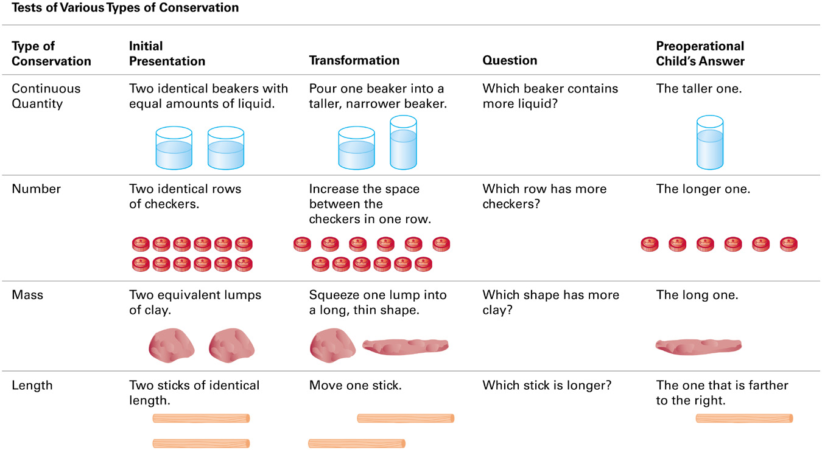
Tests of Conservation

Slide 27
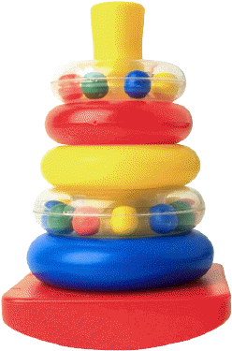
Concrete Operational Stage
Children gain a fuller understanding of conservation and other mental operations that allow them to think logically, but only about concrete events
  Conservation for liquids, numbers, and matter acquired early, but conservation of length acquired later in the stage
  Develops transitivity (e.g., if A > B, and B > C, then A > C)
  Develops seriation, the ability to order stimuli along a quantitative dimension (e.g., a set of pencils by their length)
The reasoning of concrete operational children is tied to immediate reality (i.e., what is in front of them and tangible) and not with the hypothetical world of possibility

Slide 28
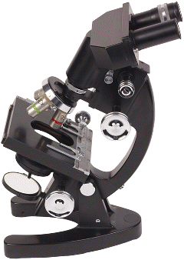
Formal Operational Stage
The child gains the capacity for hypothetical-deductive thought
  Can engage in hypothetical
  thought and in systematic
  deduction and testing of
  hypotheses

Slide 29

Formal Operational Stage
In one scientific thinking task, the child is shown several flasks of what appear to be the same clear liquid and is told one combination of two of these liquids would produce a clear liquid
  The task is to determine which combination would produce the blue liquid
  The concrete operational child just starts mixing different clear liquids together haphazardly
  The formal operational child develops a systematic plan for deducing what the correct combination must be by determining all of the possible combinations and then systematically testing each one

Slide 30
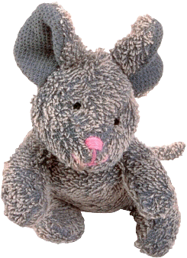
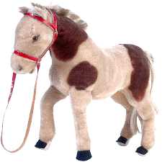

Formal Operational Stage
The formal operational child can evaluate the logic of verbal statements without referring to concrete situations
  For example, the formal operational child would judge the statement “If mice are bigger than horses, and horses are bigger than cats, then mice are bigger than cats” to be true, even though in “real life” mice are not bigger than cats

Slide 31
Evaluation of Piaget’s Theory
Recent research has shown that rudiments of many of Piaget’s key concepts (e.g., object permanence) may begin to appear at earlier stages than Piaget proposed
  For example, research that involved tracking infants’ eye movements has found that infants as young as 3 months continue to stare at the place where the object disappeared from sight, indicating some degree of object permanence

Slide 32
Evaluation of Piaget’s Theory
1. Not all people reach formal operational thought
2. The theory may be biased in favor of Western culture
3. There is no real theory of what occurs after the onset of adolescence
4. Despite refinements, recent research has indeed shown that cognitive development seems to proceed in the general sequence of stages that Piaget proposed

Slide 33

Lev Vygotsky
Socio-Cultural Theory
Agreed that children are active learners, but their knowledge is socially constructed.
Cultural values and customs dictate what is important to learn.
Children learn from more expert members of the society.
Vygotsky described the "zone of proximal development", where learning occurs.

